Slide 1

Call Volume Trend Analysis
Contents
Project Description
Approach
Tech-Stack Used
Insights
Result
- Pratyush Majumdar

Slide 2
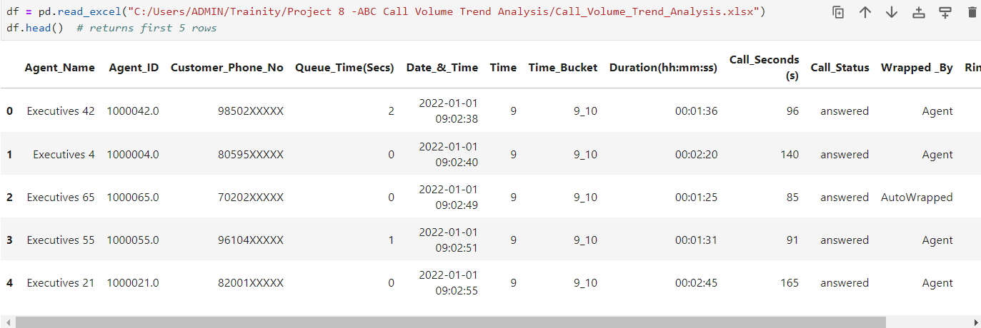
Project Description
This is a Python project in which I have performed Customer Experience (CX) Analytics for a company named ABC which operates in the insurance sector.
The objective of this project was to understand the trends in the call volume of the CX team and derive valuable insights from it.
I started by reading the dataset with the following command:

Slide 3
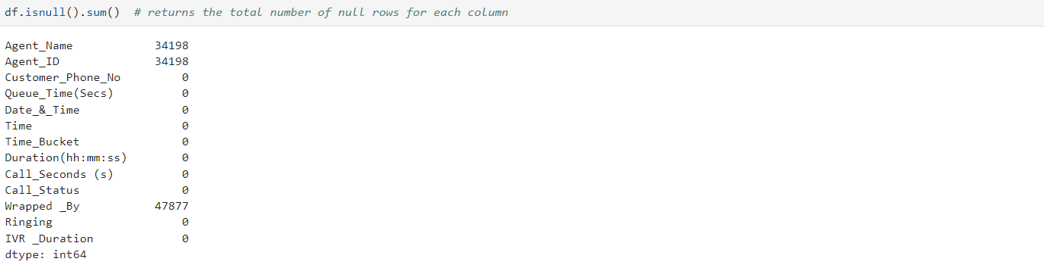
I then checked for duplicate rows with the following command:
I then checked for missing values in the dataset with the following command:

Slide 4
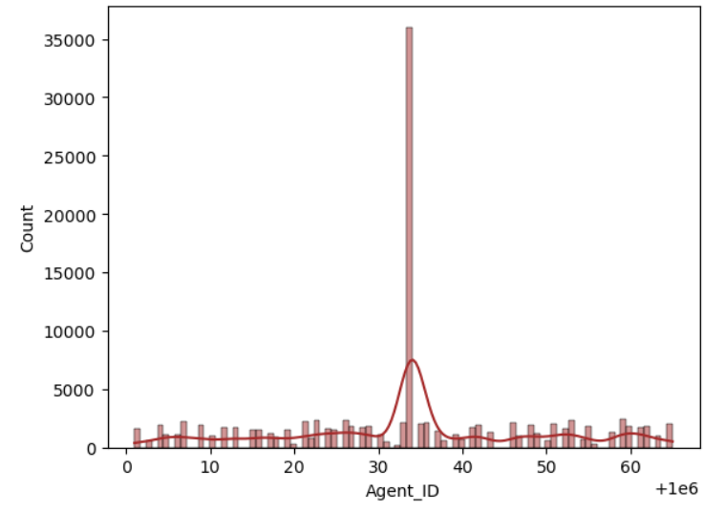
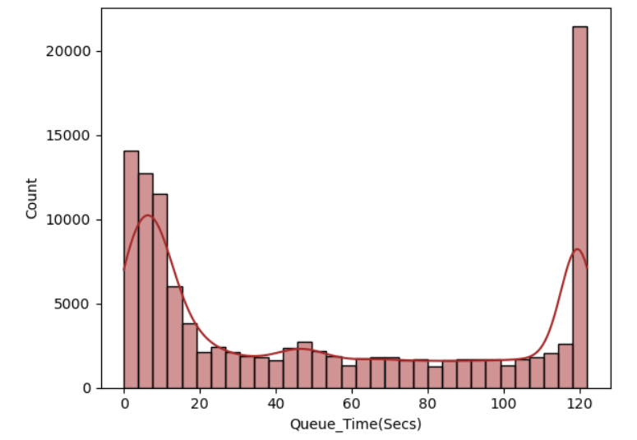
I then filled the missing values in the categorical columns with their mode and numerical columns with median.
I then checked the distribution of data by creating histograms.

Slide 5
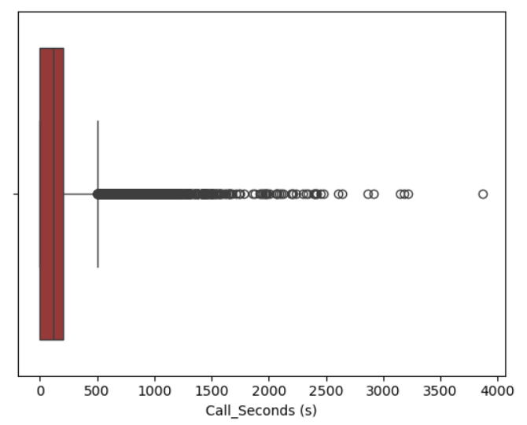
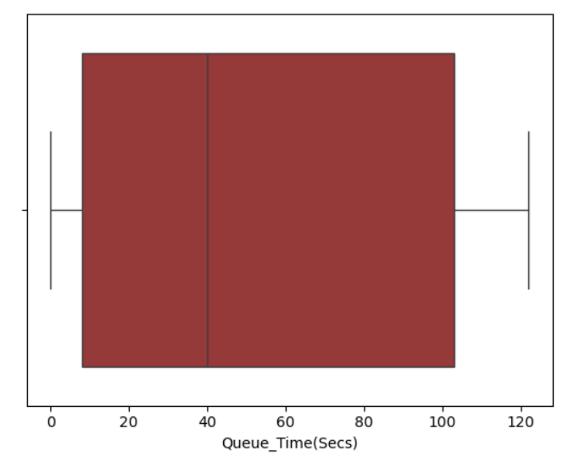
I then checked for outliers by creating box plots.
I applied threshold values for removing outliers.

Slide 6
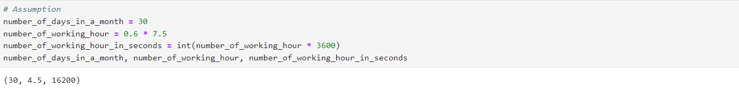
I made an assumption during this project which was:
An agent works for 6 days a week; On average, each agent takes 4 unplanned leaves per month; An agent's total working hours are 9 hours, out of which 1.5 hours are spent on lunch and snacks in the office. On average, an agent spends 60% of their total actual working hours (i.e., 60% of 7.5 hours) on calls with customers/users. The total number of days in a month is 30.

Slide 7
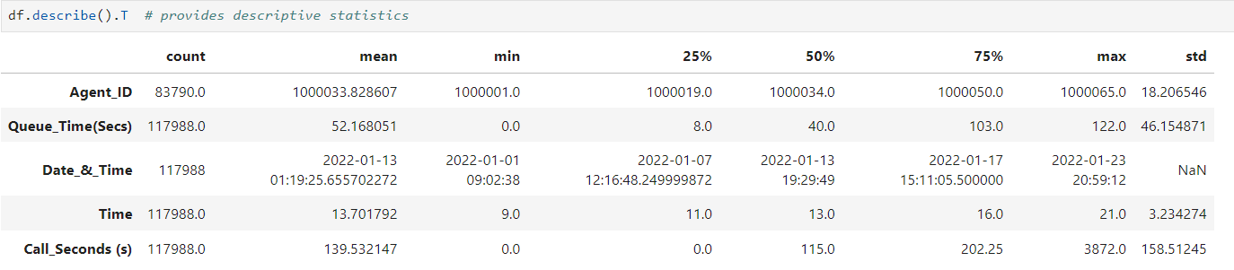
Approach
I performed Exploratory Data Analysis (EDA) for generating actionable insights.
I created visualizations like bar charts, line charts, scatter charts as it makes the data to understand in a better way.
I calculated descriptive statistics with the following command:
I got a good understanding of Advertising domain with the help of this project.

Slide 8
Tech-Stack Used
Software: Jupyter Notebook
Version: 3.11.7
I decided to use Jupyter Notebook for this project as it allows interactive data analysis and exploration. We can write code, run it, and immediately see the results within the same environment.
Although primarily used with Python, it also supports other programming languages such as R, Julia, and Scala through various kernels.
It is a versatile and powerful tool for data analysis, appealing to both beginners and experienced data scientists.
The libraries used in this project were:

Slide 9
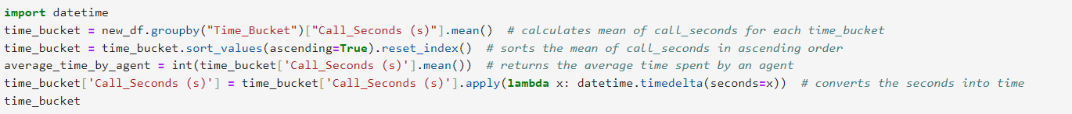
Insights
1) Average Call Duration: The first task was to find the average duration of calls for each time bucket.
I started by importing the datetime package.
I then grouped the time_bucket column and calculated call_seconds for each time_bucket.
I also calculated the average time spent by an agent.
With the help of datetime.timedelta() function, I converted the seconds into time.

Slide 10
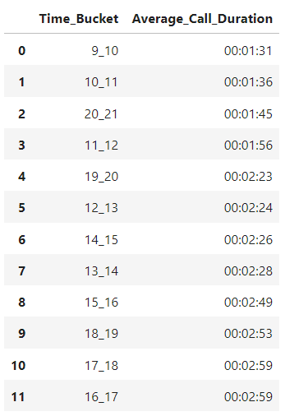
I then created a scatterplot to visualize the average call_duration for each time_bucket.

Slide 11
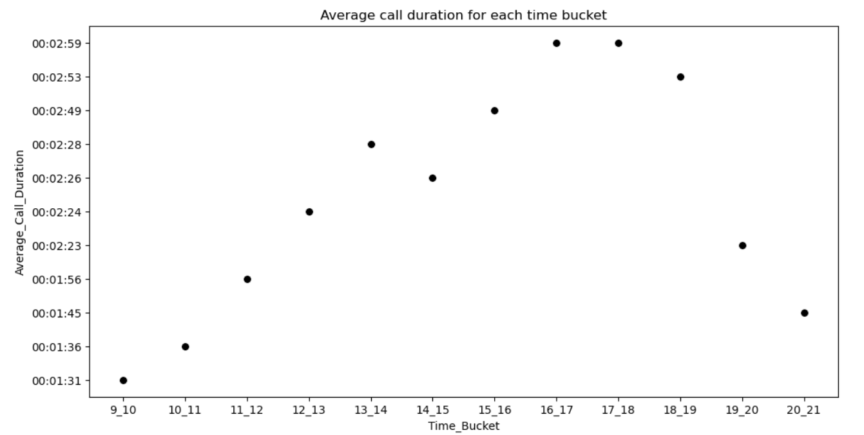

Slide 12
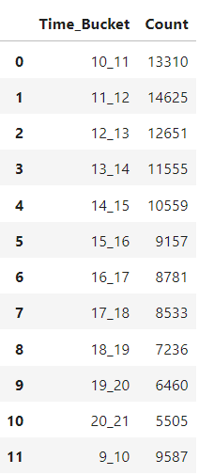
2) Call Volume Analysis: The second task was to calculate the total number of calls received for each time bucket.
I grouped the time_bucket column with the help of groupby() function and calculated the count of calls for each time_count with the help of size() function.

Slide 13
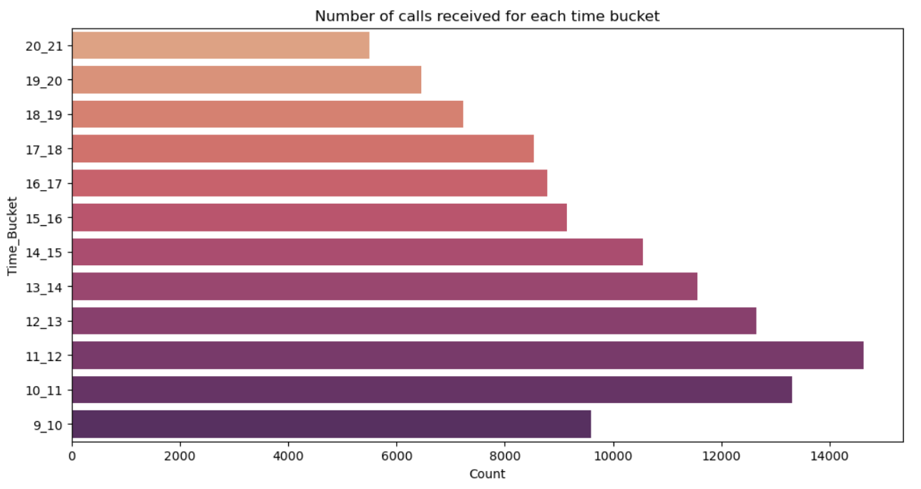

Slide 14
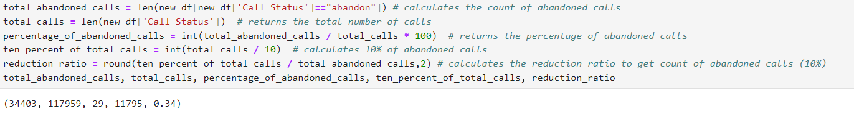
3) Manpower Planning: The third task was to calculate the minimum number of agents required in each time bucket to reduce the abandon rate to 10%.
I started by calculating the percentage of abandoned calls which was approximately 29% and then calculated the value to make it to 10%.
I then calculated the reduction ratio to multiply it with count of abandoned calls (10%) for each time_bucket.

Slide 15
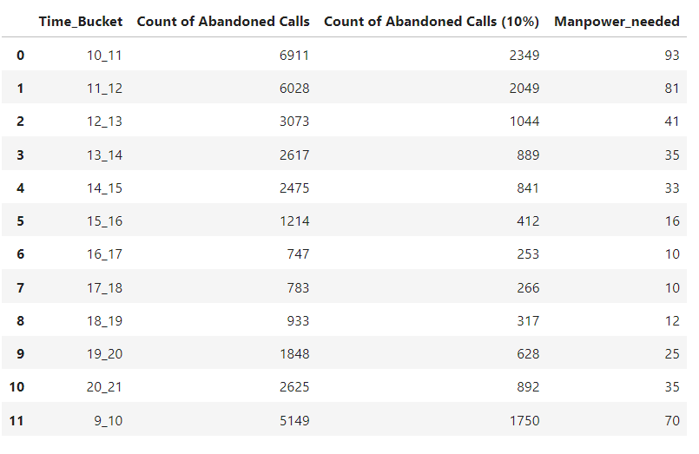
I then calculated the manpower needed for each time_bucket.
I created a barplot to visualize the minimum manpower needed to reduce abandon rate to 10%.

Slide 16
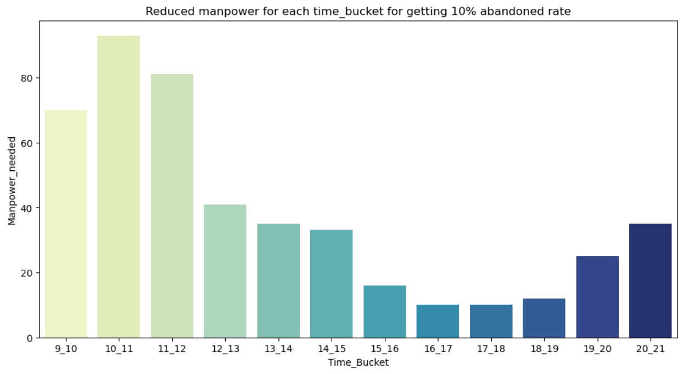

Slide 17
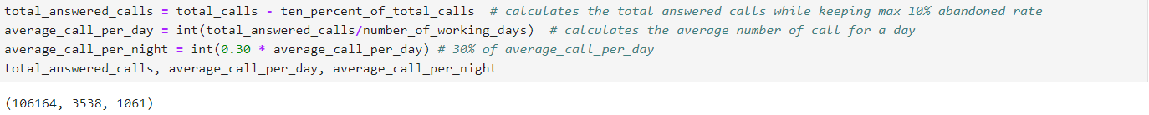
4) Night Shift Manpower Planning: The last task was to propose a manpower plan for each time bucket throughout the day, keeping the maximum abandon rate at 10%.
I started by calculating the total number of answered calls while keeping the abandoned rate at max 10%.
I then calculated the average number of call per day and then got the average number of call per night with the help of it which was (30%) of average number of call per day.
I then created a dataframe for the distribution of 30 calls coming in night for every 100 calls coming in between 9am – 9pm (i.e. 12 hours slot) with the help of pd.Dataframe() function of pandas library.

Slide 18
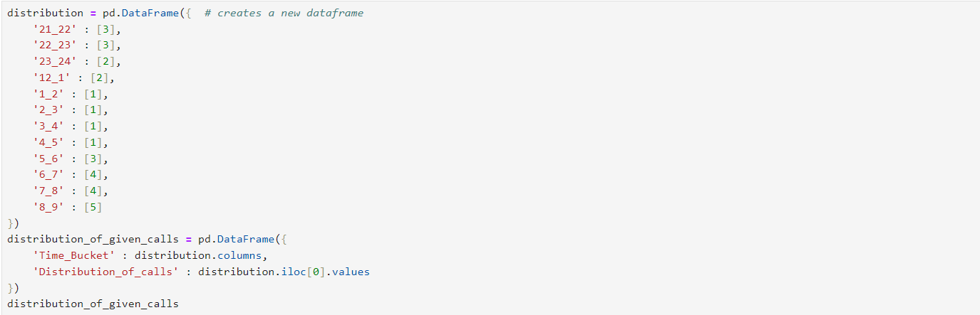
I then calculated the percentage distribution of calls for each time_bucket.

Slide 19
I then calculated the distribution of calls for night by multiplying the average_call_per_night with percentage distribution of calls for each time_bucket and converted the result into integer with the help of astype(int) function of pandas.
I then calculated the manpower_needed by dividing the distribution of calls for night with average_calls_per_hour for each time_bucket and converted the result into integer with the help of astype(int) function of pandas.

Slide 20
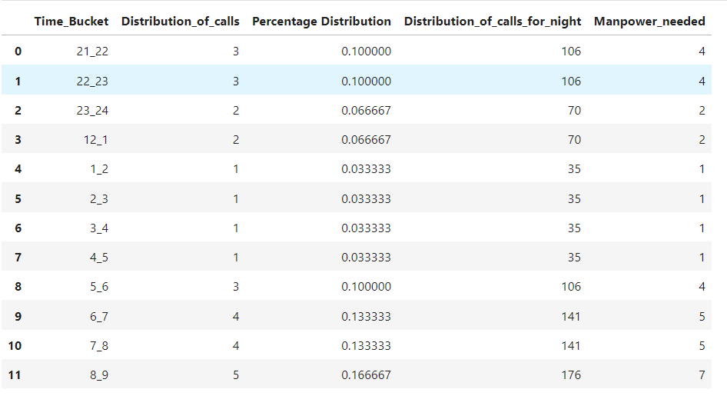
I then created a lineplot for visualizing the manpower needed for night calls.

Slide 21
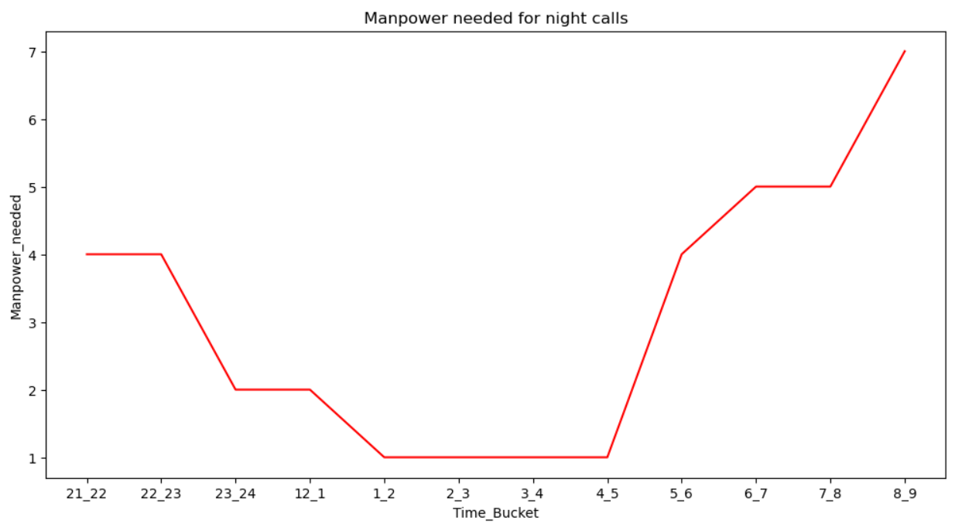
I then created a lineplot for visualizing the manpower needed for the entire day.

Slide 22
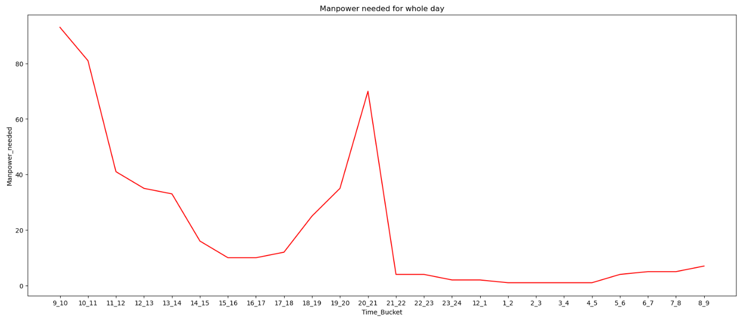

Slide 23
Result
By working on this project, I understood the role of a data analyst with respect to advertising domain.
I learned how to perform data analysis with the help of Jupyter Notebook (Python).
I understood the importance of pandas, matplotlib and seaborn libraries with the help of this project.
Additionally, I got to know about some functions in python like timedelta(), reset_index(), Categorical(), etc.
Moreover, I recognized the importance of Customer Experience Analytics in enhancing data-driven decision-making processes and improving customer satisfaction and retention.
Looking forward, I plan to leverage these skills and experiences in future projects to drive impactful data-driven decisions in the advertising industry.
Notebook link: Call Volume Trend Analysis
Thank You

